Slide 1
Introduction to SQL
EASY QUERIES FIRST Monotonic queries, or 3-liners

Slide 2
Why SQL?
SQL is a very-high-level language.
  Declarative: Say “what to do” rather than “how to do it.”
  Avoid a lot of data-manipulation details needed in procedural languages like C++ or Java.
Database management system figures out “best” way to execute query.
  Called “query optimization.”

Slide 3
SQL Motivated by
Relational Algebra [Codd 1970 paper]
Relational Calculus [Codd 1970 paper]
Do we need master Relational Algebra and /or Relational Calculus?
NO!
But we need to know some keywords like….

Slide 4
Relational Algebra
Like Boolean Algebra of Sets, but instead of SETS, on RELATIONS!
What is a difference between set and relation?

Slide 5
Relation – subset of cartesian product of sets D1 x D2….x Dn
Frequents is subset of DRINKERS X BARS
Sells is subset of BARS x BEERS

Slide 6
RELATIONAL ALGEBRA OPERATIONS
Projection
Selection
UNION
INTERSECTION/SET DIFFERENCE
JOIN

Slide 7
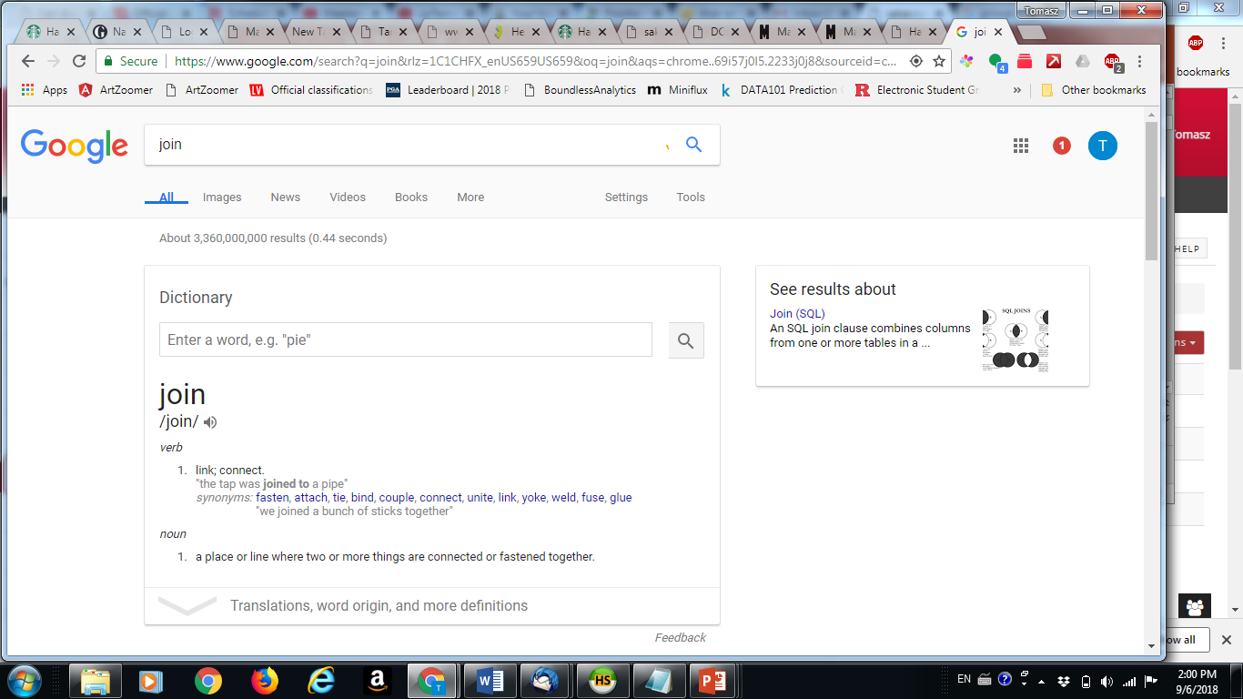
JOIN

Slide 8
Select-From-Where Statements
SELECT desired attributes
FROM one or more tables
WHERE condition about tuples of
the tables

Slide 9
JOIN
Natural Join
Join
Outer Joins (Inner Joins)
Teta-Join
COMBING TWO TABLES INTO ONE

Slide 10
Our Running Example
All our SQL queries will be based on the following database schema.
  Underline indicates key attributes.
Beers(name, manf)
Bars(name, addr, license)
Drinkers(name, addr, phone)
Likes(drinker, beer)
Sells(bar, beer, price)
Frequents(drinker, bar)

Slide 11
Now back to SQL
Hybrid of ideas of relational calculus (tuple variables) and relational algebra
Started as SEQUEL – at IBM Almaden
But grad student from Berkeley, beat them at the marker….ORACLE and Larry Ellison

Slide 12
Example
Using Beers(name, manf), what beers are made by Anheuser-Busch?
SELECT name
FROM Beers
WHERE manf = ’Anheuser-Busch’;

Slide 13
Result of Query
name
Bud
Bud Lite
Michelob
. . .
The answer is a relation with a single attribute,
name, and tuples with the name of each beer
by Anheuser-Busch, such as Bud.

Slide 14
Meaning of Single-Relation Query
Begin with the relation in the FROM clause.
Apply the selection indicated by the WHERE clause.
Apply the extended projection indicated by the SELECT clause.

Slide 15
* In SELECT clauses
When there is one relation in the FROM clause, * in the SELECT clause stands for “all attributes of this relation.”
Example: Using Beers(name, manf):
SELECT *
FROM Beers
WHERE manf = ’Anheuser-Busch’;

Slide 16
Result of Query:
name manf
Bud Anheuser-Busch
Bud Lite Anheuser-Busch
Michelob Anheuser-Busch
. . . . . .
Now, the result has each of the attributes
of Beers.

Slide 17
Renaming Attributes
If you want the result to have different attribute names, use “AS <new name>” to rename an attribute.
Example: Using Beers(name, manf):
SELECT name AS beer, manf
FROM Beers
WHERE manf = ’Anheuser-Busch’

Slide 18
Result of Query:
beer manf
Bud Anheuser-Busch
Bud Lite Anheuser-Busch
Michelob Anheuser-Busch
. . . . . .

Slide 19
Expressions in SELECT Clauses
Any expression that makes sense can appear as an element of a SELECT clause.
Example: Using Sells(bar, beer, price):
SELECT bar, beer,
price*114 AS priceInYen
FROM Sells;

Slide 20
Result of Query
bar beer priceInYen
Joe’s Bud 285
Sue’s Miller 342
… … …

Slide 21
Complex Conditions in WHERE Clause
Boolean operators AND, OR, NOT.
Comparisons =, <>, <, >, <=, >=.
  And many other operators that produce boolean-valued results.

Slide 22
Example: Complex Condition
Using Sells(bar, beer, price), find the price Joe’s Bar charges for Bud:
SELECT price
FROM Sells
WHERE bar = ’Joe’’s Bar’ AND
beer = ’Bud’;

Slide 23
Patterns
A condition can compare a string to a pattern by:
  <Attribute> LIKE <pattern> or <Attribute> NOT LIKE <pattern>
Pattern is a quoted string with % = “any string”; _ = “any character.”

Slide 24
Example: LIKE
Using Drinkers(name, addr, phone) find the drinkers with exchange 555:
SELECT name
FROM Drinkers
WHERE phone LIKE ’%555-_ _ _ _’;

Slide 25
Multirelation Queries
Interesting queries often combine data from more than one relation.
We can address several relations in one query by listing them all in the FROM clause.
Distinguish attributes of the same name by “<relation>.<attribute>” .

Slide 26
Example: Joining Two Relations
Using relations Likes(drinker, beer) and Frequents(drinker, bar), find the beers liked by at least one person who frequents Joe’s Bar.
SELECT beer
FROM Likes, Frequents
WHERE bar = ’Joe’’s Bar’ AND
Frequents.drinker = Likes.drinker;

Slide 27
Other way
Select L.beer
From Likes L JOIN Frequents F on L.drinker=F.drinker
Where F.bar=‘Joe’s’

Slide 28
Example
drinker bar drinker beer
tv1 tv2
Sally Bud
Sally Joe’s
Likes
Frequents
to output
check
for Joe
check these
are equal

Slide 29
Explicit Tuple-Variables
Sometimes, a query needs to use two copies of the same relation.
Distinguish copies by following the relation name by the name of a tuple-variable, in the FROM clause.
It’s always an option to rename relations this way, even when not essential.

Slide 30
3-LINERS
Select A1….An
From R1,….Rn
Where CONDITION
These queries I also call MONOTONE

Slide 31
MONOTONE QUERIES
If you add more tuples (content) to the database, the answer to query never shrinks
By adding tuples to DB, you cannot make tuples from query answer disappear

Slide 32
Example
MONOTONE: Students who take databases
Drinkers who drink Corona
Drinkers who frequent bars which serve beers they like

Slide 33
NON-MONOTONE
Students who DO NOT take databases
Drinkers who frequent ONLY bars which sell beers that they like

Slide 34
Question – what does this query return?
        Select L1.drinker
        from Likes L1,Likes L2
        where L1.drinker=L2.drinker and not(L1.beer =L2.beer)
        A: Drinkers who do not like the same beer
        B: Drinkers who do not like any beer
        C: Drinkers who like at least two beers
        D: Drinkers who like at most two beers

Slide 35
Subqueries
A parenthesized SELECT-FROM-WHERE statement (subquery ) can be used as a value in a number of places, including FROM and WHERE clauses.
Example: in place of a relation in the FROM clause, we can use a subquery and then query its result.
  Must use a tuple-variable to name tuples of the result.

Slide 36
Example: Subquery in FROM
Find the beers liked by at least one person who frequents Joe’s Bar.
SELECT beer
FROM Likes, (SELECT drinker
FROM Frequents
WHERE bar = ’Joe’’s Bar’)JD
WHERE Likes.drinker = JD.drinker;
Drinkers who
frequent Joe’s Bar

Slide 37
Subqueries That Return One Tuple
If a subquery is guaranteed to produce one tuple, then the subquery can be used as a value.
  Usually, the tuple has one component.
  A run-time error occurs if there is no tuple or more than one tuple.

Slide 38
Example: Single-Tuple Subquery
Using Sells(bar, beer, price), find the bars that serve Miller for the same price Joe charges for Bud.
Two queries would surely work:
  Find the price Joe charges for Bud.
  Find the bars that serve Miller at that price.

Slide 39
Query + Subquery Solution
SELECT bar
FROM Sells
WHERE beer = ’Miller’ AND
price = (SELECT price
FROM Sells
WHERE bar = ’Joe’’s Bar’
AND beer = ’Bud’);
The price at
which Joe
sells Bud

Slide 40
The IN Operator
<tuple> IN (<subquery>) is true if and only if the tuple is a member of the relation produced by the subquery.
  Opposite: <tuple> NOT IN (<subquery>).
IN-expressions can appear in WHERE clauses.

Slide 41
Example: IN
Using Beers(name, manf) and Likes(drinker, beer), find the name and manufacturer of each beer that Fred likes.
SELECT *
FROM Beers
WHERE name IN (SELECT beer
FROM Likes
WHERE drinker = ’Fred’);
The set of
beers Fred
likes

Slide 42
IN is a Predicate About R’s Tuples
SELECT a
FROM R
WHERE b IN (SELECT b FROM S);
Two 2’s
a b
1 2
3 4
R
b c
2 5
2 6
S
(1,2) satisfies
the condition;
1 is output once.
One loop, over
the tuples of R

Slide 43
This Query Pairs Tuples from R, S
SELECT a
FROM R, S
WHERE R.b = S.b;
a b
1 2
3 4
R
b c
2 5
2 6
S
(1,2) with (2,5)
and (1,2) with
(2,6) both satisfy
the condition;
1 is output twice.
Double loop, over
the tuples of R and S

Slide 44
The Exists Operator
EXISTS(<subquery>) is true if and only if the subquery result is not empty.
Example: From Beers(name, manf) , find those beers that are the unique beer by their manufacturer.

Slide 45
Example: EXISTS
SELECT name
FROM Beers b1
WHERE NOT EXISTS (
SELECT *
FROM Beers
WHERE manf = b1.manf AND
name <> b1.name);
Notice scope rule: manf refers
to closest nested FROM with
a relation having that attribute.
Set of
beers
with the
same
manf as
b1, but
not the
same
beer
Notice the
SQL “not
equals”
operator

Slide 46
Question: what does this query return?
Select s.bar from sells s
Where ((s.beer= ‘Corona’ ) OR (s.beer=‘Bud’) )AND
NOT EXIST(Select s1.bar
From sells s1, sells s2
Where (s1.beer = ‘Corona’ ) AND (s2.beer = ‘Bud) AND (s.bar=s1.bar) AND (s.bar=s2.bar))
Bars which serve both Corona and Bud
Bars which serve Corona or Bud but not both
Bars which do not serve Corona or do not serve Bud

Slide 47
The Operator ANY
Example: x >= ANY(<subquery>) means x is not the uniquely smallest tuple produced by the subquery.

Slide 48
The Operator ALL
Example: x >= ALL(<subquery>) means there is no tuple larger than x in the subquery result.

Slide 49
Example: ALL
From Sells(bar, beer, price), find the beer(s) sold for the highest price.
SELECT beer
FROM Sells
WHERE price >= ALL(
SELECT price
FROM Sells);
price from the outer
Sells must not be
less than any price.

Slide 50
Union, Intersection, and Difference
Union, intersection, and difference of relations are expressed by the following forms, each involving subqueries:
  (<subquery>) UNION (<subquery>)
  (<subquery>) INTERSECT (<subquery>)
  (<subquery>) EXCEPT (<subquery>)
  * The last two options NOT available in mysql ☹

Slide 51
Question: what does this query return?
SELECT b.name
FROM bar b
WHERE NOT EXISTS (SELECT * FROM frequents f WHERE f.bar= b.name)
Bars which are not frequented by everybody
Bars which are not frequented by anybody
Bars which are frequented by somebody

Slide 52
Bag Semantics
Although the SELECT-FROM-WHERE statement uses bag semantics, the default for union, intersection, and difference is set semantics.
  That is, duplicates are eliminated as the operation is applied.

Slide 53
Controlling Duplicate Elimination
Force the result to be a set by SELECT DISTINCT . . .
Force the result to be a bag (i.e., don’t eliminate duplicates) by ALL, as in . . . UNION ALL . . .

Slide 54
Example: DISTINCT
From Sells(bar, beer, price), find all the different prices charged for beers:
SELECT DISTINCT price
FROM Sells;
Notice that without DISTINCT, each price would be listed as many times as there were bar/beer pairs at that price.

Slide 55
Join Expressions
SQL provides several versions of (bag) joins.
These expressions can be stand-alone queries or used in place of relations in a FROM clause.

Slide 56
Products and Natural Joins
Natural join:
R NATURAL JOIN S;
Product:
R CROSS JOIN S;
Example:
Likes NATURAL JOIN Sells;
Relations can be parenthesized subqueries, as well.

Slide 57
Theta Join
R JOIN S ON <condition>
Example: using Drinkers(name, addr) and Frequents(drinker, bar):
Drinkers JOIN Frequents ON
name = drinker;
gives us all (d, a, d, b) quadruples such that drinker d lives at address a and frequents bar b.

